Slide 1
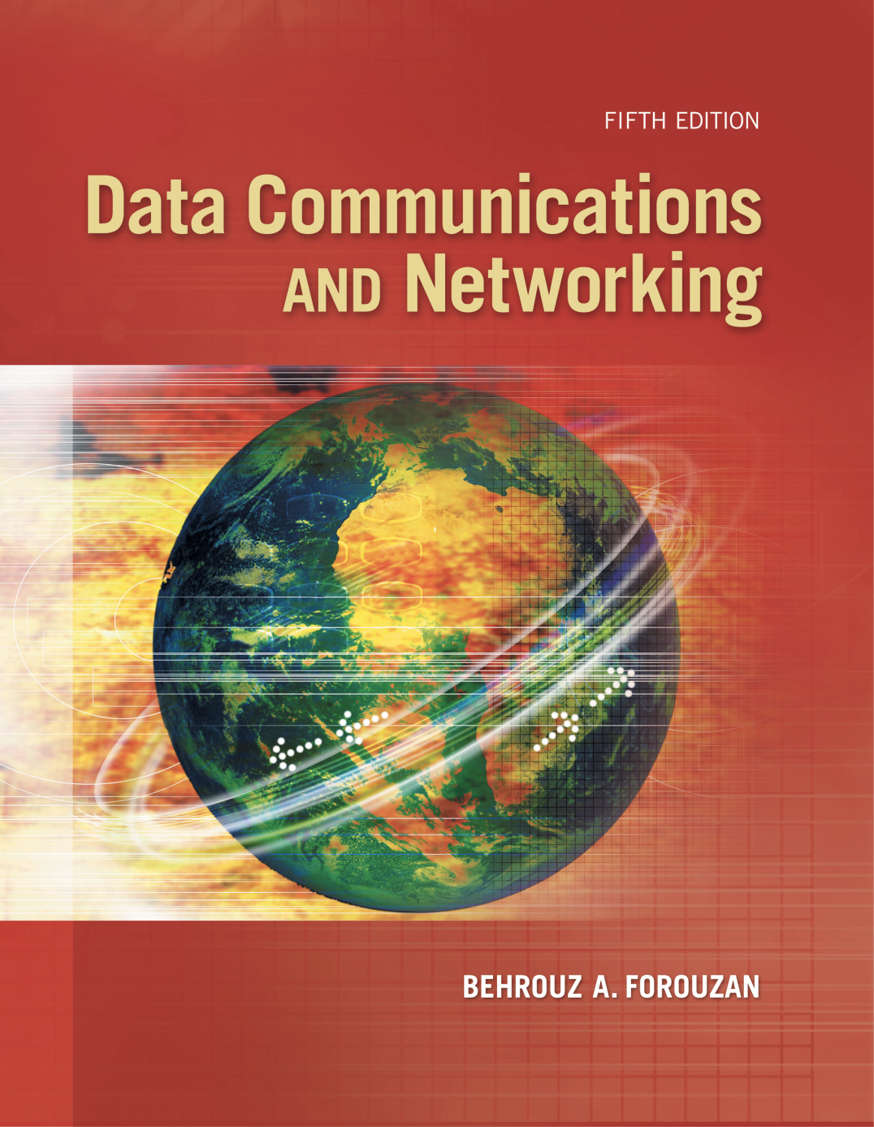
Chapter 9
Introduction
To
Data-Link
Layer
.

Slide 2
Chapter 9: Outline
9.1 INTRODUCTION
Define the concept of links and nodes
Describe the services provided by the data-link layer
Define two categories of links: point-to-point and broadcast links
Define two sub-layers at the data-link layer
9.2 LINK-LAYER ADDRESSING
Discuss link-layer addressing
Discuss the Address Resolution Protocol (ARP)

Slide 3
9-1 INTRODUCTION
Internet
A combination of networks glued together by connecting devices (routers or switches). If a packet is to travel from a host to another host, it needs to pass through these networks.
For the following Figure, only one data-link layer is involved at the source or destination. Two data-link layers are involved at each router.

Slide 4
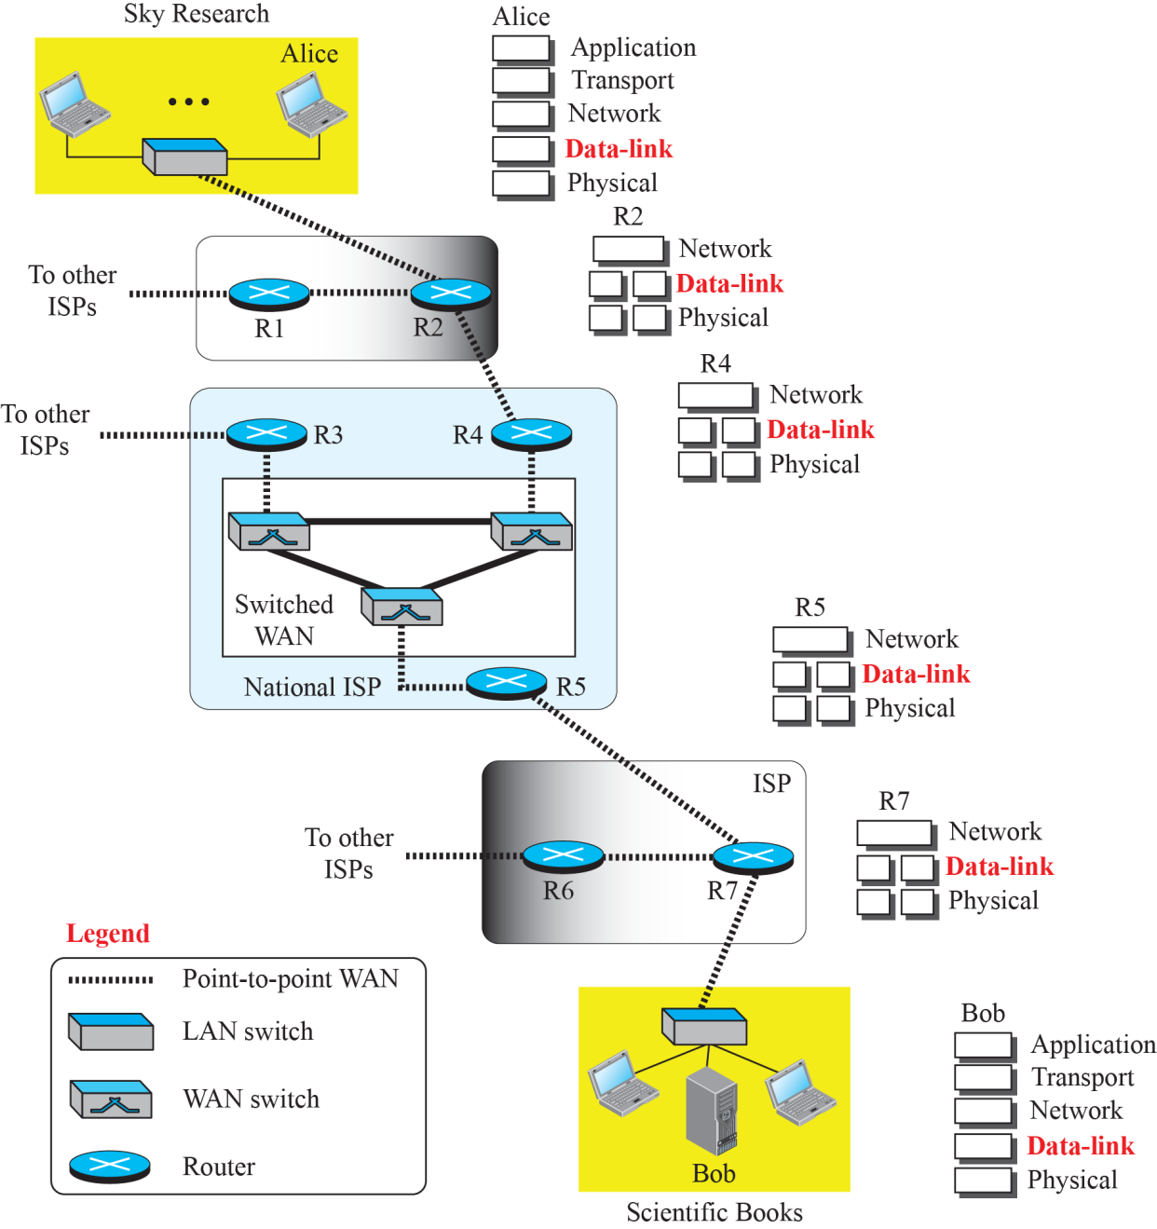
Communication at the data-link layer

Slide 5
9.1.1 Nodes and Links
Communication at the data-link layer is node-to-node.
A data unit from one point in the Internet needs to pass through many networks (LANs and WANs) to reach another point.
LANs and WANs are connected by routers.
Refer to the two end hosts and the routers as nodes and the networks in between as links.

Slide 6
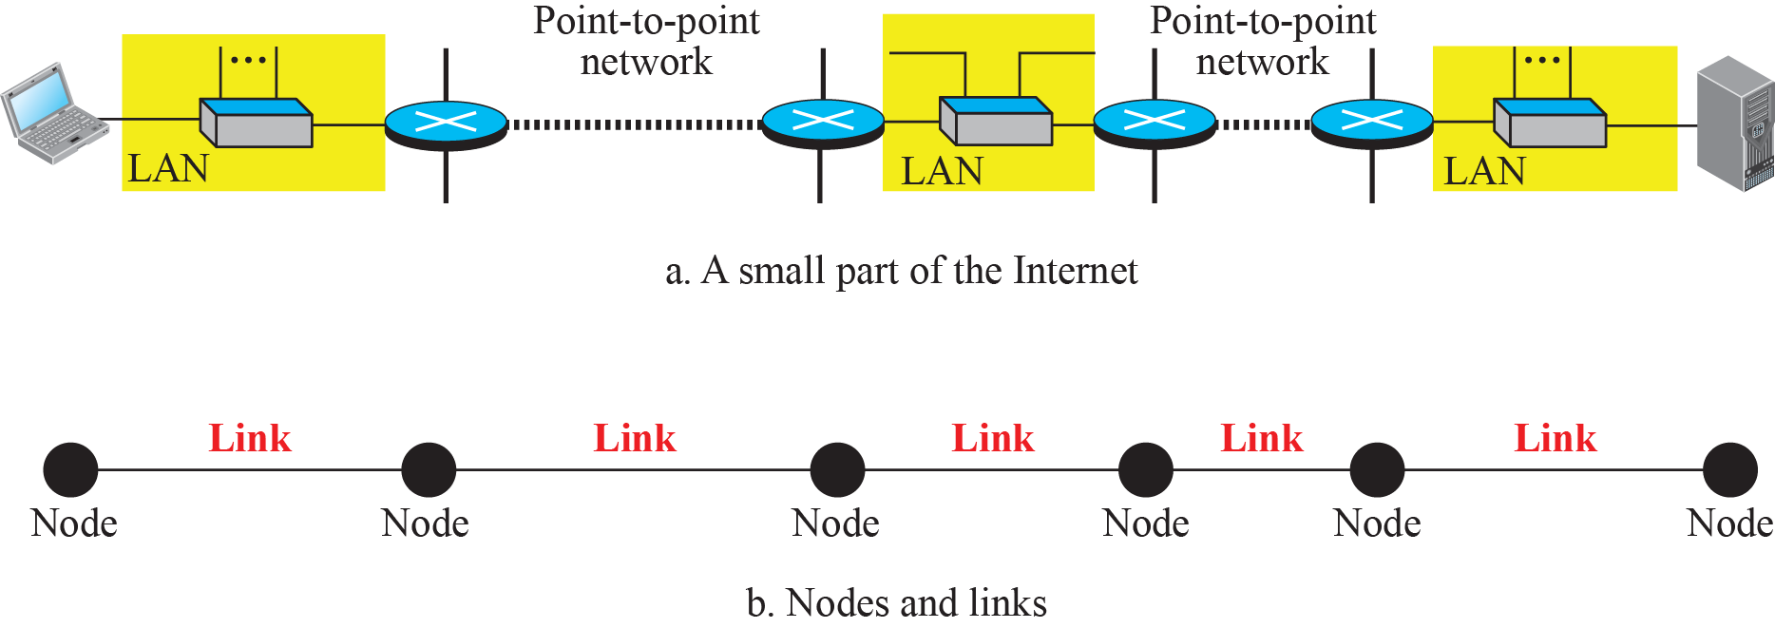
Figure 9.2 is a simple representation of links and nodes when the path of the data unit is only six nodes and five links (three LANs & two WANs).
Figure 9.2: Nodes and Links

Slide 7
9.1.2 Services
The data-link layer
Provide services to the network layer.
Receive services from the physical layer.
The sending node encapsulate the datagram in a frame. The receiving node decapsulate the datagram from the frame.

Slide 8
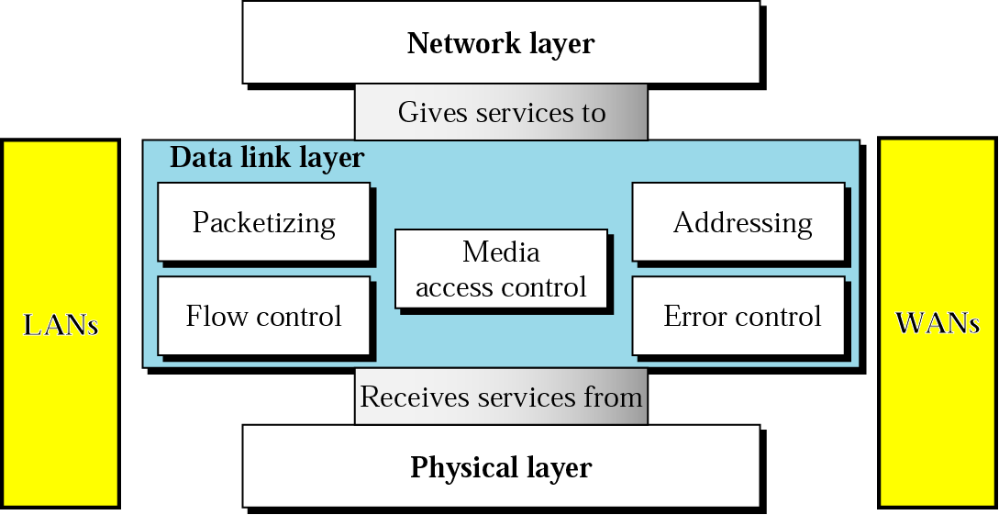
Data Link Services
The data-link layer
Provide services to the network layer;
Receive services from the physical layer.

Slide 9
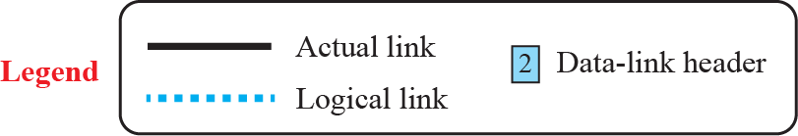
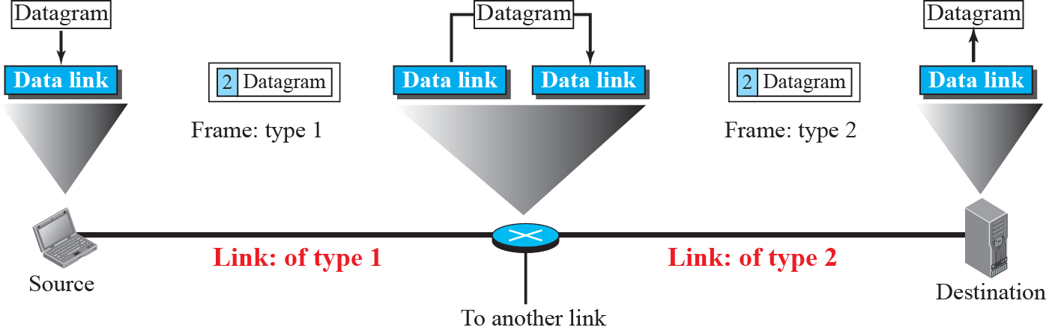
A communication with only three nodes

Slide 10
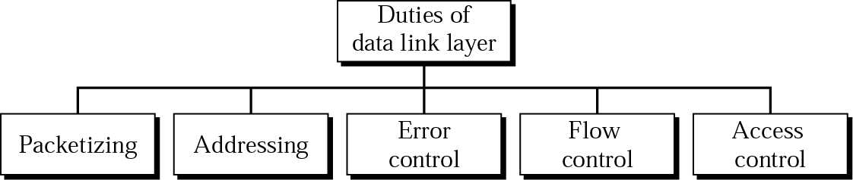
Data link layer services
Responsible for carrying a packet from one hop
(computer or router) to the next hop.
framing

Slide 11
Data link layer services
Framing
Different data-link layers have different format for framing
Addressing (Using ARP)
Find the hardware address of next hop in hop-to-hop delivery
Error control across a link.
Make sure a packet arrives safe and sound between two hops
Flow control
Make sure next hop is not overwhelmed with data by the previous hop.
Media access control for a multiple access link.
Define the procedure a computer follows when it needs to send a frame.

Slide 12
9.1.3 Two Categories of Links
Data-link layer controls how the medium is used.
A data-link layer that uses the whole capacity of the medium, or a point-to-point link.
A data-link layer that uses only part of the capacity of the link, or a broadcast link.

Slide 13
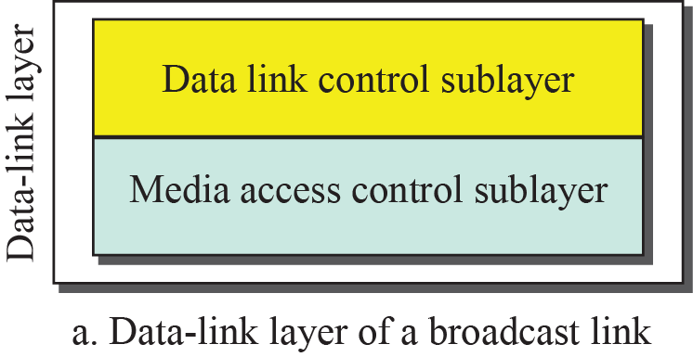
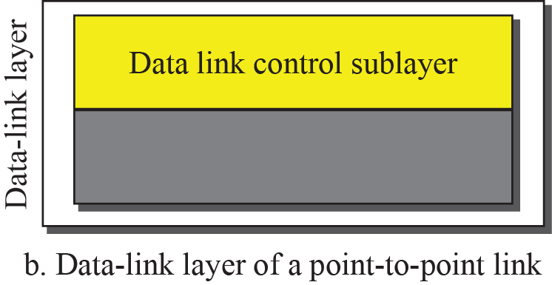
9.1.4 Two Sublayers
Data-link layer is divided into two sublayers:
Data link control (DLC) and
Media access control (MAC).

Slide 14
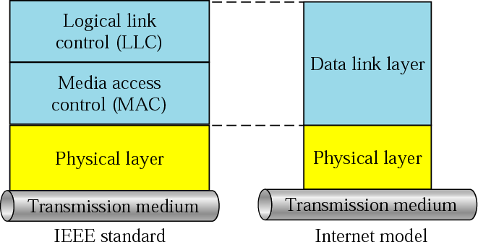
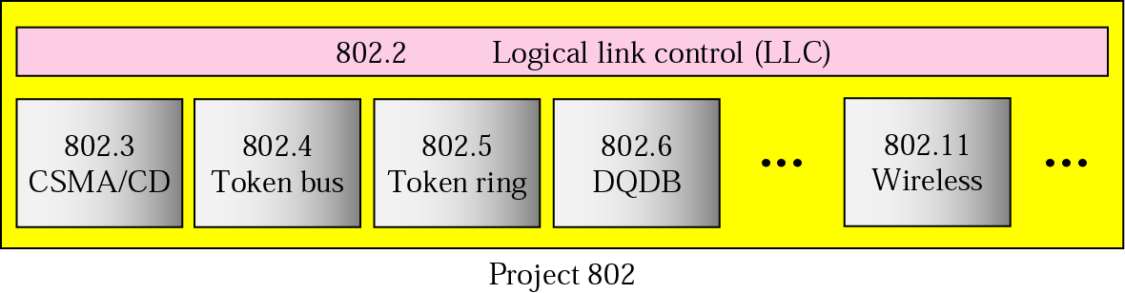
IEEE standards for LANs
Many distinct
LAN modules
802.3: Ethernet
802.6: Metropolitan Area Network
802.11: WiFi
802.16: WiMax

Slide 15
9-2 LINK-LAYER ADDRESSING
The source and destination IP addresses define the two ends but cannot define which links the packet should pass through. The IP address should not be changed.
We need another address in a connectionless internetwork, which is link-layer address, physical address, or MAC address.
The two MAC addresses for data-link layer are changed when the frame moves from one link to another.
A router has n pairs of addresses, where n is the number of links the router is connected to.

Slide 16
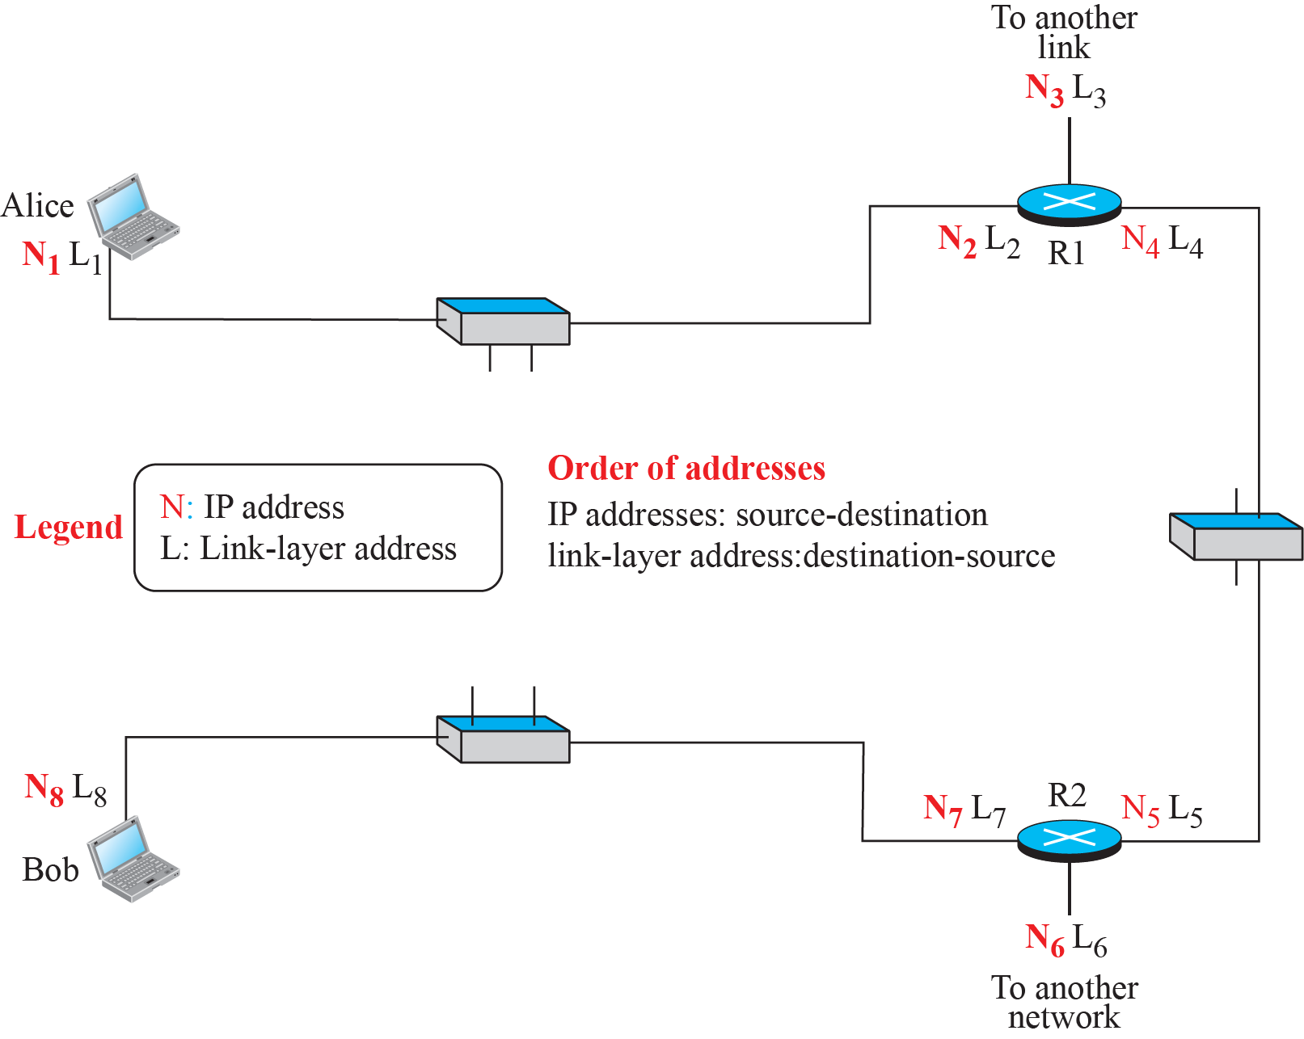
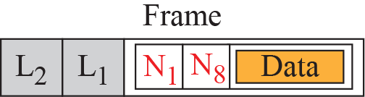
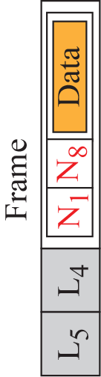
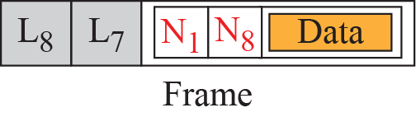
IP addresses and link-layer addresses in a small internet

Slide 17
Why do we need to assign IP addresses to routers?
A router has network layer and hence needs an IP
Why do we need more than one IP address in a router?
A router with n interfaces is connected to the Internet at n points, where each point needs an IP address for that LAN (WAN).
How do I have an IP@ for end devices?
By manual configuration or by using DHCP.
Does my laptop use the same IP@ all the time?
No, IP@ is location dependent. So your laptop will have different IP@ when you connect to Internet at different location.

Slide 18
How are the source and destination IP addresses determined in data transmission?
The source host knows its own IP address.
The application layer uses the services of DNS to find the destination IP address.
How are the source and destination link-layer addresses determined for each link?
The host knows its own link-layer address.
The destination link-layer address is determined by using the ARP.
What is the size of link-layer addresses?
It depends on the protocol used by the link. We may use different data-link protocols in different links.

Slide 19
9.2.1 Three Types of link-layer addresses
Some link-layer protocols define three types of addresses:
Unicast: one-to-one communication
Multicast: one-to-many communication
Broadcast: one-to-all communication

Slide 20
Example 9.1
The unicast link-layer addresses in the most common LAN, Ethernet, are 48 bits (six bytes) that are presented as 12 hexadecimal digits separated by colons;
For example, the following is a link-layer address of a computer. The second digit needs to be an odd number.
A3:34:45:11:92:F1

Slide 21
Example 9.2
In the multicast link-layer addresses, the second digit, needs to be an even number in hexadecimal.
The following shows a multicast address:
A2:34:45:11:92:F1

Slide 22
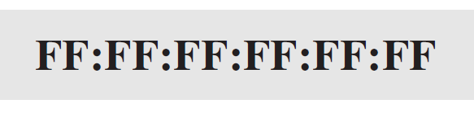
Example 9.3
The broadcast link-layer addresses is all 1s, that are presented as 12 hexadecimal digits separated by colons.
The following shows a broadcast address:

Slide 23
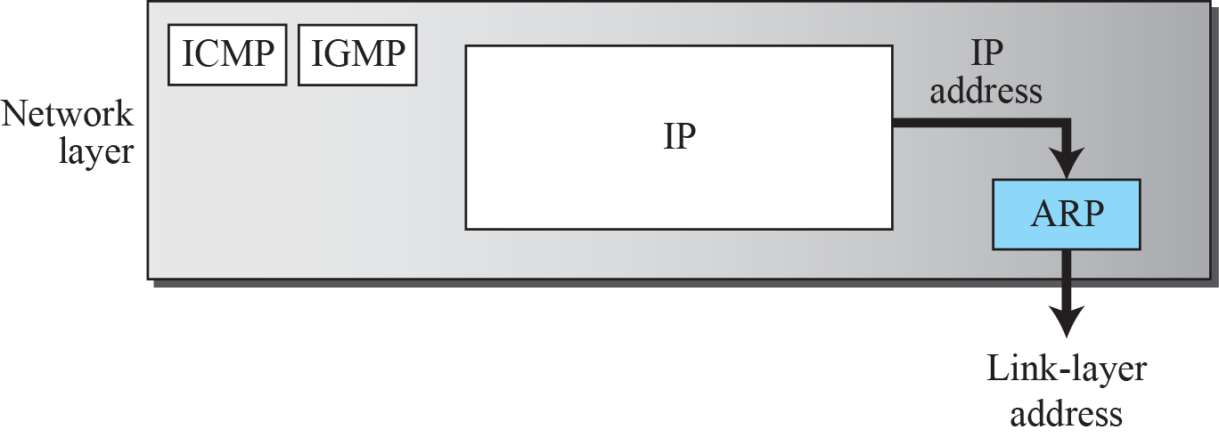
9.2.2 ARP: Address services
The IP address of the next node is not helpful in moving a frame through a link.
Need the link-layer address of the next node.
Address Resolution Protocol (ARP) provides such an address translation service. It belongs to the network layer.

Slide 24
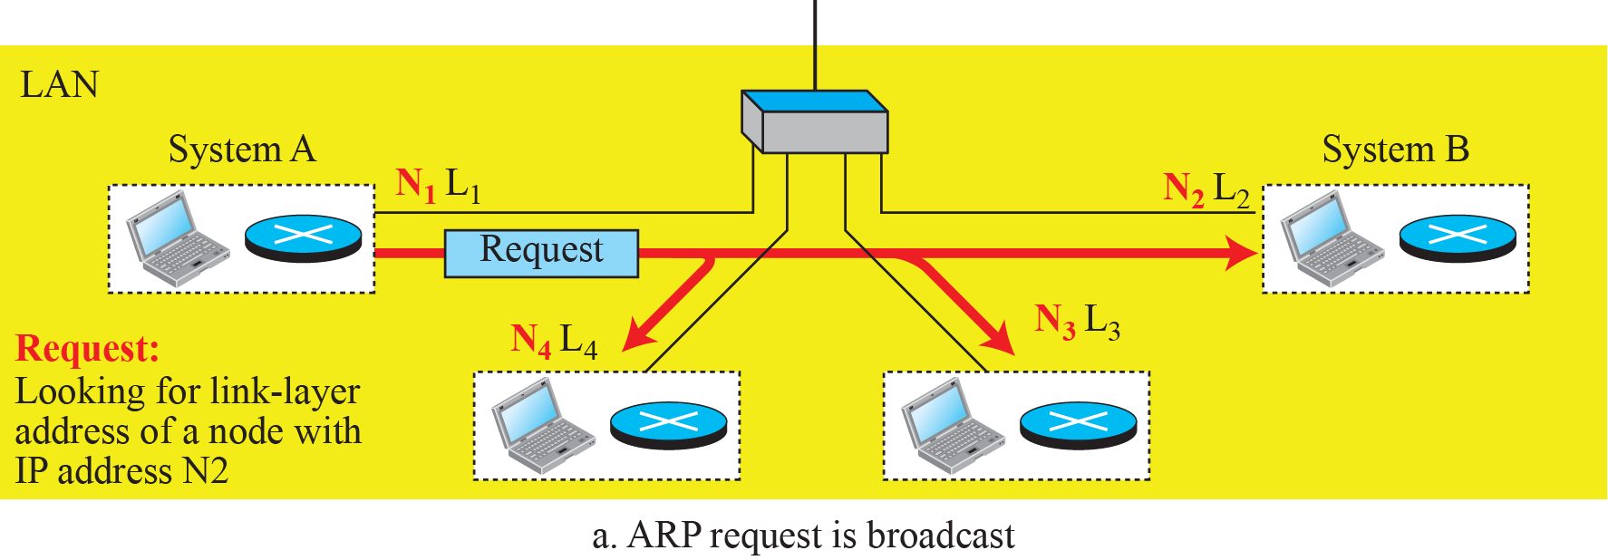
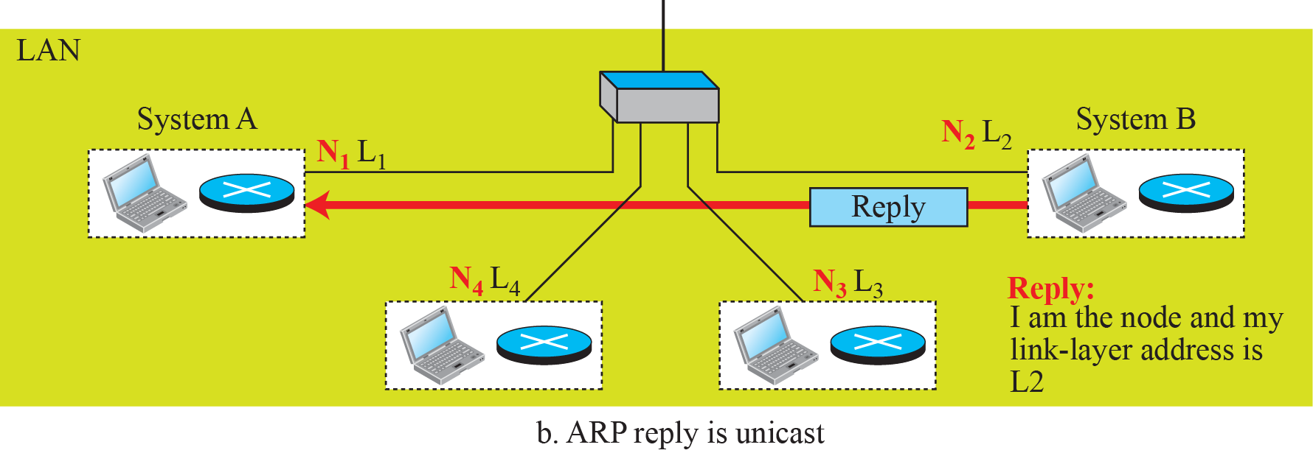
ARP operation
A host or router sends an ARP request packet with broadcast. The intended recipient sends back an ARP response packet with unicast.

Slide 25
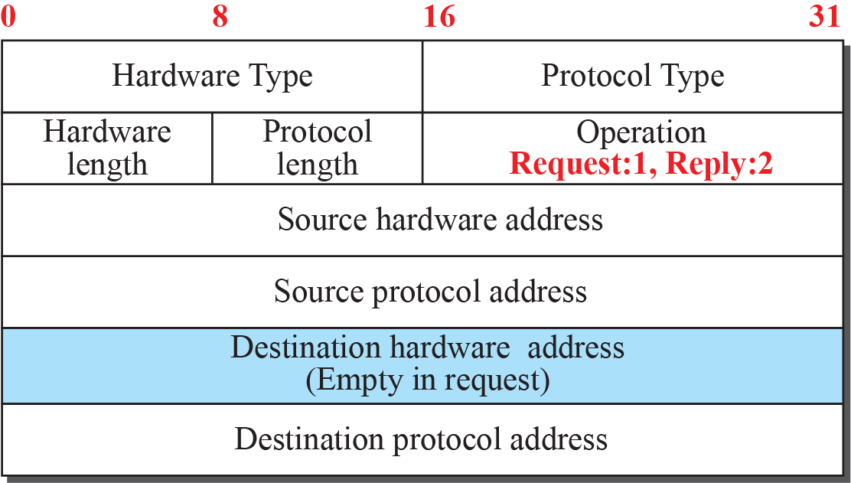
ARP packet
Hardware: LAN or WAN protocol (Ethernet is 1)
Protocol: Network-layer protocol (IPv4 is (0800)₁₆)
MAC address
IP address
MAC address
IP address

Slide 26
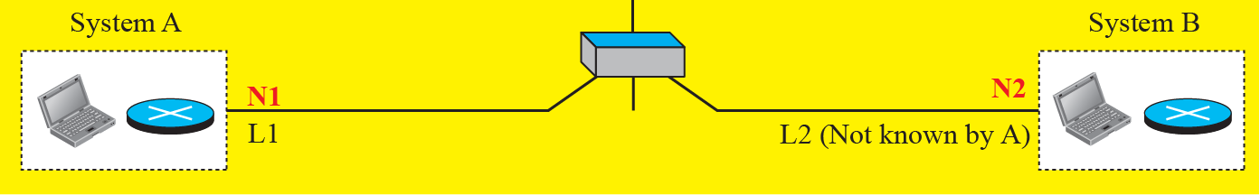
Example 9.4
A host with IP address N1 and MAC address L1 has a packet to send to another host with IP address N2 and physical address L2 (which is unknown to the first host).
The two hosts are on the same network.

Slide 27
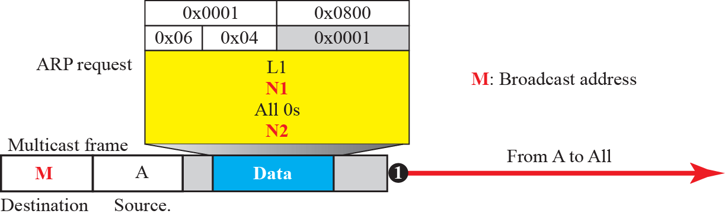
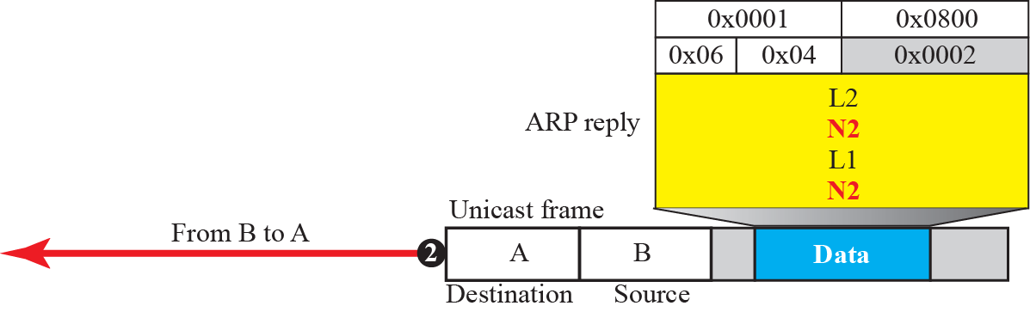
Figure 9.9: Example 9.4
Ethernet
IPv4
HW@6 bytes
=A
1s
M=FF:FF:FF:FF:FF:FF
=B
=A
N1

Slide 28
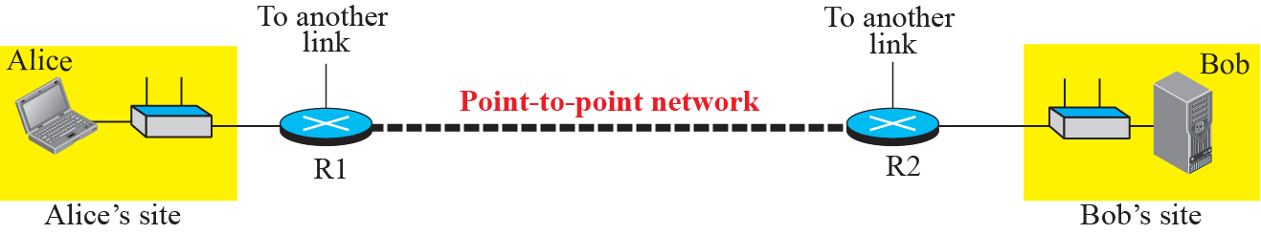
9.2.3 An Example of Communication with Internet
N₁: Serving router of Alice

Slide 29
Configuration Table
IP address | 140.138.22.15
Serving gateway | 140.138.22.23
MASK | 255.255.254.0
DNS | 140.138.44.54
… | …

Slide 30
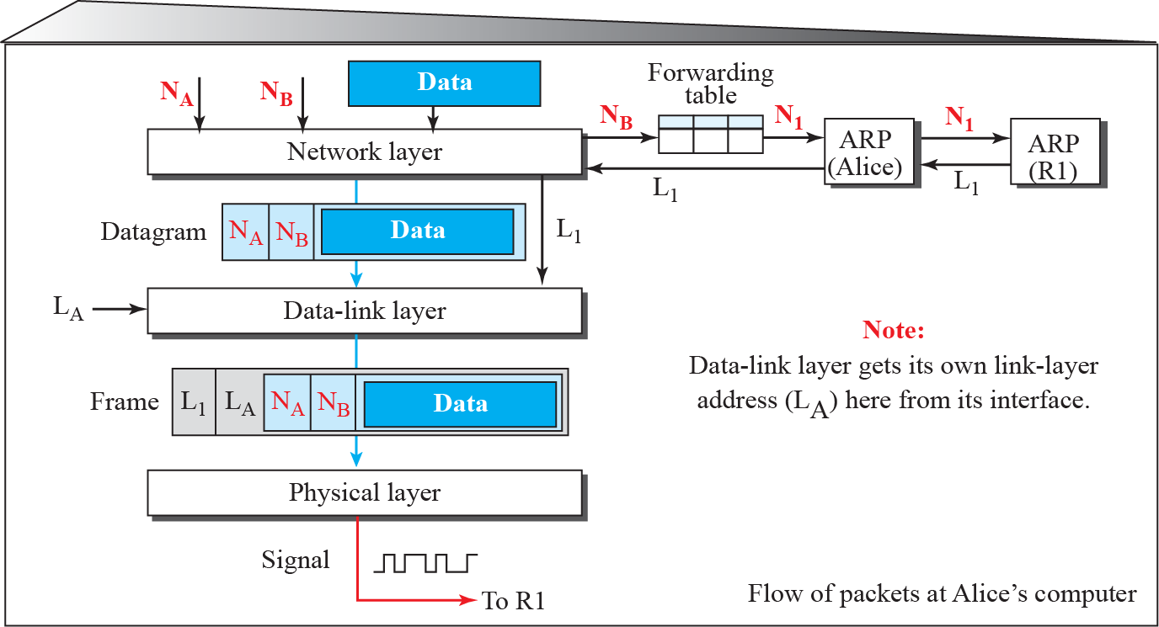
Flow of packets at Alice site
N₁: Serving router of Alice

Slide 31
Forwarding Table
Cached MAC@
Destination address | MAC address
Serving gateway 140.138.22.23 | A3:34:45:11:92:F1
140.138.15.98 | B9:87:32:67:23:A1
… | …
… | …

Slide 32
What is my next hop?
Is the destination (NB) in the same LAN as the source (NA)? Or do I need the help of local router?
How?
Compare the netID of source and destination.
How to know the netID?
Every sub-network has a configured mask.
A mask defines the length of netID in network address.

Slide 33
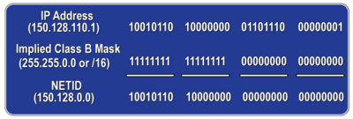
What is my next hop?
In the example, netID is two byes in the most significant bytes.
Masking is just to do (IP@.AND.MASK)

Slide 34
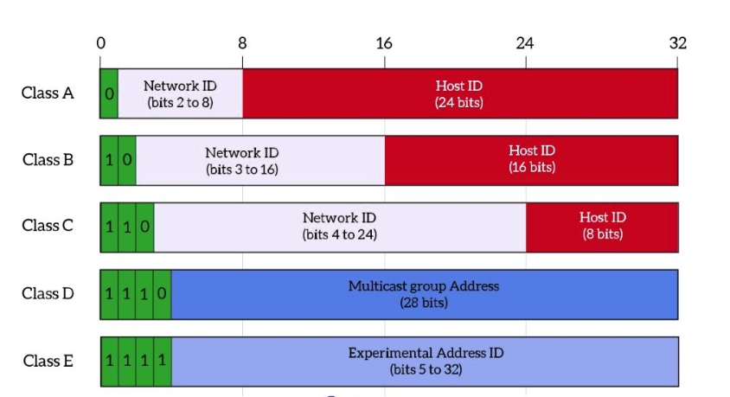
IPv4 Standard Network Identifier

Slide 35
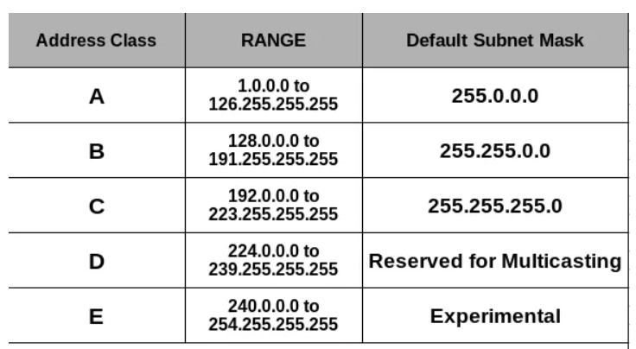
Address Range and Mask

Slide 36
Network Identifier of YZU
MASK for IPv4: 11111111.11111111.00000000.00000000
255.255.0.0 or /16
IP address=netid.hostid.
Mask indicates the number of bits are used for netid, and is in the form, e.g. 255.255.0.0 or /16

Slide 37
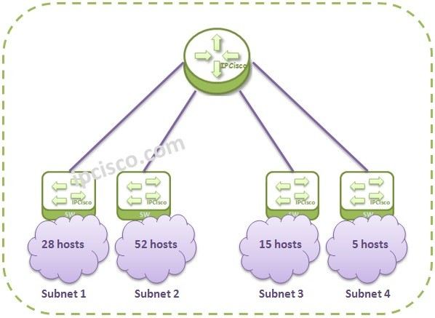
Subnetting
Breakdown a network into smaller networks with unique network identifiers.

Slide 38
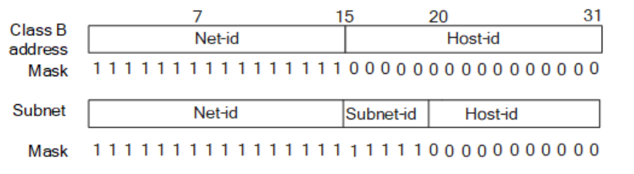
Subnet mask, number and size
Support 2**5 = 32 subnets.
Each subnet has 2**11 = 2048 IP@
Maximally each subnet can connect 2046 devices (excluding all “0” (network id) and all “1” (broadcasting) in Host-id.

Slide 39
IP address=netid.hostid. Host id=0 is used for netid identifier and Host id= all 1 is used for broadcasting address in the subnet.
140.138.0.0: netID
140.138.255.255: broadcasting address

Slide 40
Net-id + Subnet-id: Identify a network.
How many bits of IP@ is used as the netID (Net-Id +Subnet-Id) if MASK is 255.255.128.0?
MASK 255.255.254.0?

Slide 41
Question-1
Given a subnet with mask 255.255.254.0/23.
Node A has logic and MAC address as 140.138.150.45 and MAC44. What is the netID of the subnet?
Node B is with NB=140.138.153.52 and MAC11. What is netID of NB?
Are NA and NB at the same subnet or LAN?

Slide 42
140.138.150.45 | 10001100 | 10001010 | 10010110 | 00101101
Mask=/23 | 11111111 | 11111111 | 11111110 | 00000000
netID=140.138.150 | 10001100 | 10001010 | 10010110 | 00000000
140.138.153.52 | 10001100 | 10001010 | 10011001 | 00110100
Mask=/23 | 11111111 | 11111111 | 11111110 | 00000000
netID=140.138.152 | 10001100 | 10001010 | 10011000 | 00000000
Node A netid≠ node B netid, so A and B are not in the same LAN or subnet.

Slide 43
What is my next hop?
If NA and NB are not in the same LAN or subnet, we need the serving router or gateway to provide routing services.
ARP is used if NA does not know the MAC@ of the serving gateway.

Slide 44
How to find MAC@ of next hop
Netid(N_{B})=
Net_mask(N_{B})
Netid(N_{B})=Netid(N_{A})?
Apply
ARP protocol
yes
Is MAC found?
yes
no
no
Next hop =N_{B}
Next hop =N₁
MAC@=
ARP (next hop)
MAC@ from cache table
Check Forwarding Table for next hop.
Return
MAC@

Slide 45
Question-2
Node A has logic and MAC address as 140.138.150.45 and MAC44.
Node B is with NB=140.138.153.52 and MAC11.
If mask=255.255.240.0/20, is NA and NB in the same LAN?

Slide 46
140.138.150.45 | 10001100 | 10001010 | 10010110 | 00101101
Mask=/20 | 11111111 | 11111111 | 11110000 | 00000000
netID=140.138.144 | 10001100 | 10001010 | 10010000 | 00000000
140.138.153.52 | 10001100 | 10001010 | 10011001 | 00110100
Mask=/20 | 11111111 | 11111111 | 11110000 | 00000000
netID=140.138.144 | 10001100 | 10001010 | 10010000 | 00000000
Node A netid = node B netid, so A and B are in the same LAN or subnet.
So the node B IP@ is used at ARP

Slide 47

Question
Given a port on the router has a mask: 255.255.255.128/25. If a node with 140.138.131.133 belongs to the subnet, what range of IP@ can be used for the router for this port.
If the mask is 255.255.255.192/26, what range of IP@ is appropriate for the router on the port?

Slide 48
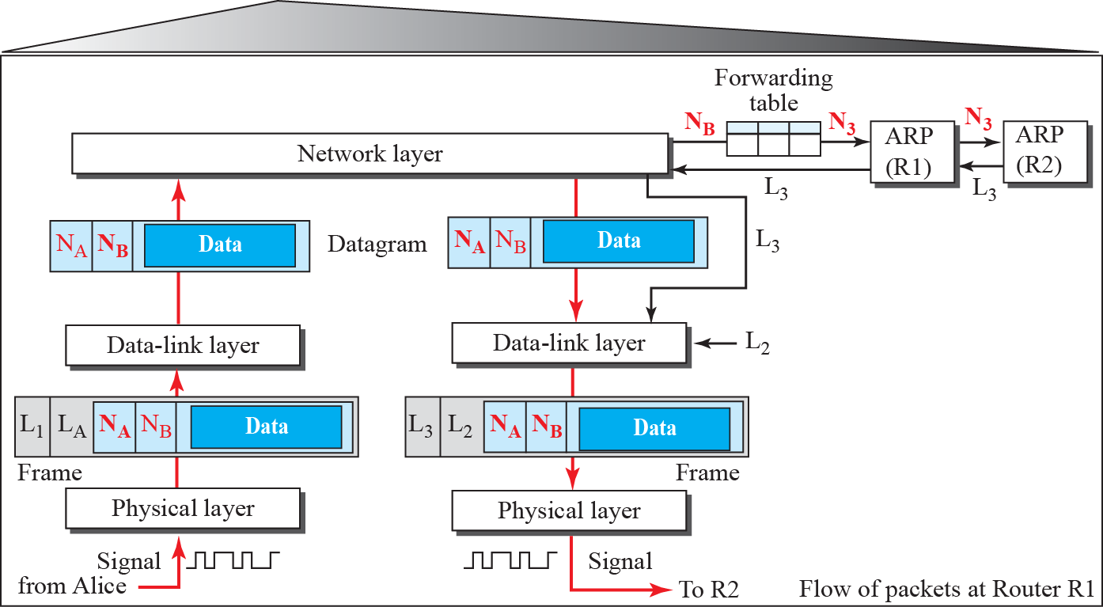
Flow of activities at router R1
Find MAC@
Routing decision

Slide 49
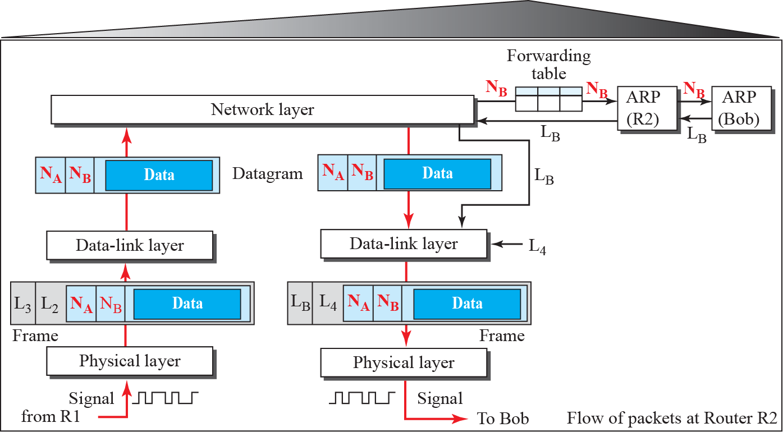
Flow of activities at router R2
No change
Change per hop

Slide 50
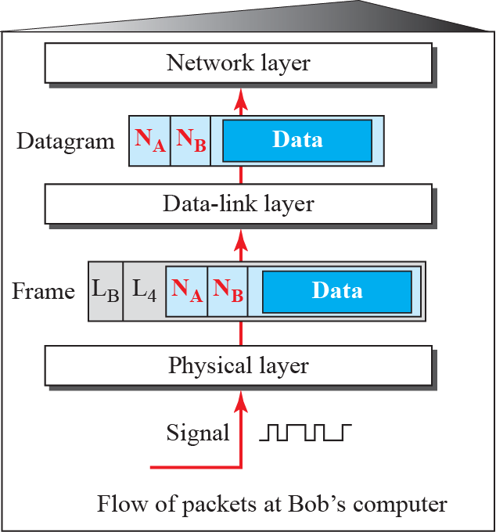
Activities at Bob’s site

Slide 51
Summary
Data link layer determines the use of a link, either point-to-point or broadcasting.
Data link layer transforms unreliable bit pipe at the physical layer to a reliable link.
Data link layer address changes hop by hop.
Network layer uses ARP to acquire data link address.
Destination data link address can be either the MAC@ of destination node or next hop router node.

